Slide 1

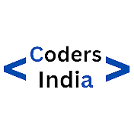


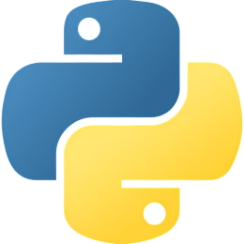





Agenda
Python Comments
Python Syntax

Slide 2

Python Comments

Slide 3
What is Python Comments ?
Comments are notes you write in your code to explain what the code does.
They help others (or even yourself in the future) understand the purpose of different parts of the code.

Slide 4

Types of Python commants....
Single-line Comments
Multi-line Comments
Documenting Functions and Classes

Slide 5
Single Line comment ...
Single-line comments begin with the # symbol. Anything after # on the same line is considered a comment and is ignored by the Python interpreter.
# This is a single-line comment
x = 10 # This is also a single-line comment

Slide 6
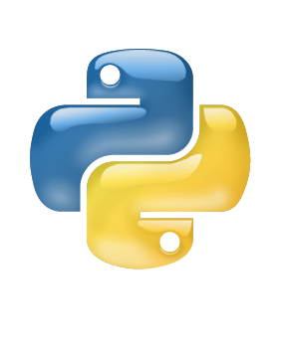
Multi-line Comments ...
Python doesn't have a built-in syntax for multi-line comments like some other programming languages. However, you can use triple quotes (''' or """) to create multi-line strings, which are often used as multi-line comments.
'''
This is a multi-line comment.
It spans across multiple lines.
'''

Slide 7
Documenting Functions and Classes
When you create functions or classes in Python, it's helpful to document what they do, especially if someone else will use your code. You can do this by adding explanations right inside your code. For functions, you write a description just below the function name, saying what it does, what inputs it needs, and what it gives back. This helps others understand how to use the function correctly. Similarly, for classes, you explain what the class is for, what properties it has, and what methods it provides. This way, anyone reading your code can quickly understand how to work with your functions and classes.

Slide 8
Documenting Functions and Classes
def add(x, y):
'''
This function adds two numbers.
Parameters:
x (int): The first number.
y (int): The second number.
Returns:
int: The sum of x and y.
'''
return x + y

Slide 9
Thank You
For Your Attention

